Slide 1
A Simple Framework for Contrastive Learning of Visual Representations
Ting Chen, Simon Kornblith, Mohammad Norouzi, Geoffrey Hinton (July 2020)
Presented by: Tomer Himi.

Slide 2
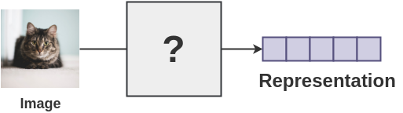
Representation Learning
Representation learning replaces the need for manual feature engineering and allows a machine to both learn the features and use them to perform a specific task. It is a field of its own in Machine Learning and often becomes much of the actual effort in deploying machine learning algorithms.
Notes:
Representation learning may leverage the fact that there are many huge unlabeled datasets, which can be learnt from both for supervised and unsupervised purposes. The goal is to find a representation function $f(⋅)$, such that replacing our input $x$ with $f(x)$ captures meaningful information regarding our task and may reduce the computational and statistical complexity associated with it. The quality of the representation is then measured by its success on downstream tasks*.
More related info
For images learned in supervised learning, there is proof of existence for broadly useful representations is the output of the penultimate layer(the one before the softmax) of a network trained on the ImageNet dataset.
Unsupervised representation learning aims at extracting features representation from an unlabeled dataset for downstream tasks such as classification. An unsupervised representation learning model is typically learnt by solving a pretext task* without supervised information. Trained model work as a feature extractor for supervised tasks. Learning and Evaluating Let $U=\{x_{n}\}$ be a large set of unlabeled samples and $S=\left\{\left(x_{m},y_{m}\right)\right\}$ be a small set of labeled samples, then our learning method consists of two optimization problems: 1) We learn our unsupervised representation with an encoder denoted $f(⋅)$ by solving:
$θ^{∗}={argmin}_{θ}\frac{1}{N}\sum_{n=1}^{N}{ℓ_{un}\left(f_{θ}\left(x_{n}\right)\right)}$
2) We learn our classifier on the representations by solving:
$ψ^{∗}={argmin}_{ψ}\frac{1}{N}\sum_{n=1}^{N}{ℓ_{Sup}\left(h_{ψ}\left(f_{θ^{∗} }\left(x_{m}\right)\right),y_{m}\right)}$
Where $H$ is the class of simple functions used to evaluate the goodness of the representations.
*Pretext tasks are pre-designed tasks for systems to solve, features are learned by learning objective functions of tasks.
*Downstream tasks are computer vision applications that are used to evaluate the quality of features learned by self-supervised learning. These applications can greatly benefit from the pertained models when training data are scarce.

Slide 3
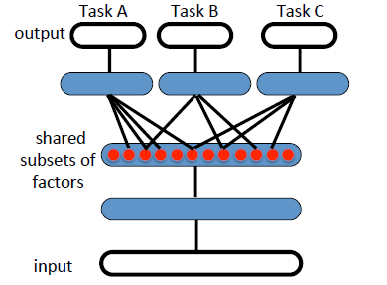
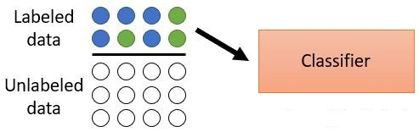
Uses of Representations
Transfer Learning
Model Complexity Reduction
Sample Complexity Reduction
Figure 3. Illustration of our dataset which consists of both labeled And unlabeled data. We learn our representations on the labeled data And then train a classifier on those representations instead of the original labeled data.
Figure 1. Illustration of representation-learning discovering explanatory factors (middle hidden layer, in red), some explaining the input (semi-supervised settings) And some explaining the
target for each task. Because these subsets overlap, sharing of statistical strength helps generalization
Figure 2. Representations of the data are shown
to be linearly separable
Notes:
Uses of representations
Transfer Learning is the ability of a learning algorithm to exploit commonalities between different learning tasks in order to share statistical strength, and transfer knowledge across tasks. There is a hypothesize that representation learning algorithms have an advantage for such tasks, because they learn representations that capture underlying factors, a subset of which may be relevant for each task. This hypothesis seems confirmed by several empirical results showing the strengths of representation learning algorithms in transfer learning scenarios.
Model Complexity Reduction- For AI-tasks, such as vision and NLP, it seems hopeless to rely only on simple parametric models(such as linear models), because they can’t capture enough of the complexity of interest unless provided with the appropriate feature space.
Sample Complexity Reduction- A useful representation which allows us to learn a simpler function may suggest that our task can be learnt with fewer samples. Statistical Learning theory quantifies the requirement as a function of the VC Dimension. Other analysis methods include Natarajan’s Dimension, Rademacher Complexity and PAC Bayesian learning. We would like to make use of this theory to learn representations from a large set of unlabeled data and train our simple models on our small sets of labeled data.

Slide 4
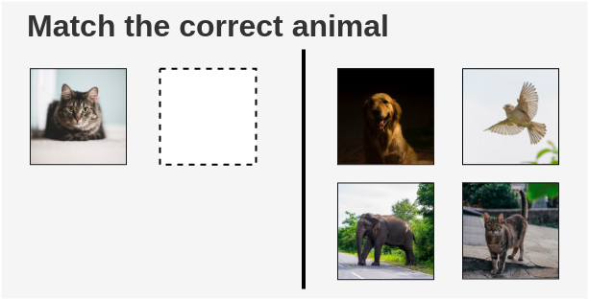
Intuition of Contrastive Learning
The way a child would solve it is by looking at the cat at the left side and search for a cat on the right side. Thus, learning to contrast the cat from other animals and develop features for recognizing cats by similarity.
Notes:
The main idea of contrastive learning is to learn representations such that similar samples stay close to each other, while dissimilar ones are far apart. When working with unsupervised data, contrastive learning is one of the most powerful approaches in self-supervised learning*. Contrastive unsupervised representation Learning is a method of learning representations which respect similarity: leveraging availability of “similar” and “dis-similar” data points. The learner forces the similarity score of representations of similar samples with each other to be higher on average than with dissimilar samples by minimizing a contrastive loss.
This article presents a simple and efficient framework to use unlabeled image data to learn visual representations which respect a measure of similarity between images. This representation should reduce the requirements for labeled data on downstream tasks such as classification and improve their performance.
Assumptions and Intuitions
Gathering unlabeled data is certainly easier than gathering labeled data, but how do we get access to data with the specific structure needed for contrastive learning? If we ask humans to manually find similarities between samples, we may as well just ask them to label the data and use supervised methods for classification.
Instead we would like to be able to automatically find the structure or to generate this structure ourselves.
If we decide to automatically find the structure, then we need to find a representation and similarity function which the computer can understand.
*self-supervised learning- This is where we train a model using labels that are naturally part of the input data, rather than requiring separate external labels. we can achieve this by framing a supervised learning task in a special form to predict only a subset of information using the rest. In this way, all the information needed, both inputs and labels, has been provided.
We use self- supervised learning when we would like something which works better, but doesn't will need a huge amount of data.

Slide 5
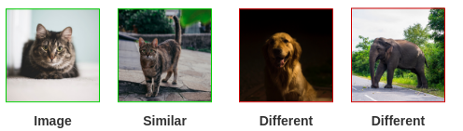
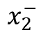
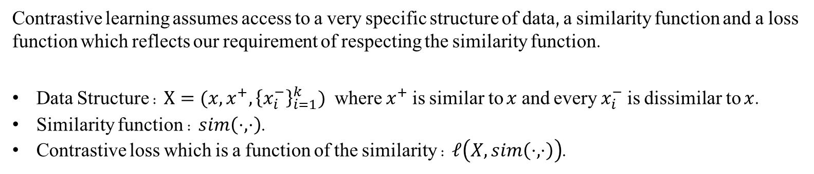
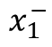
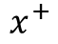
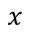
Framework for Contrastive Learning
Contrastive learning assumes access to a very specific structure of data, a similarity function and a loss function which reflects our requirement of respecting the similarity function.
Data Structure : $X=(x,x^{+},{\left\{x_{i}^{−}\right\}}_{i=1}^{k})$ where $x^{+}$ is similar to $x$ and every $x_{i}^{−}$ is dissimilar to $x$.
Similarity function : $sim\left(⋅,⋅\right)$.
Contrastive loss which is a function of the similarity : $ℓ\left(X,sim\left(⋅,⋅\right)\right)$.
$$x$$
$$x^{+}$$
$$x_{1}^{−}$$
$$x_{2}^{−}$$
Notes:
Why should it work ?
While it seems intuitive that minimizing such loss functions should lead to representations that capture ‘similarity’,
formally it is unclear why the learned representations should do well on downstream linear classification tasks – their somewhat mysterious success is often treated as an obvious consequence. To analyze this success, a framework must connect ‘similarity’ in unlabeled data with the information that is implicitly present in downstream tasks such as classification.
Recent literature has attempted to relate the success of their methods to maximization of mutual information between latent representations. However, it is not clear if the success of contrastive approaches is determined by mutual information or by the specific form of the contrastive loss.
Framework Analysis
To analyze this success a framework must connect ‘similarity’ in unlabeled data with the information that is implicitly present in downstream tasks. We formalize the notion of similarity by introducing latent classes where similar pairs are assumed to be drawn from the same latent class and A downstream task is comprised of a subset of these latent classes.
Let $C$ be the set of latent classes and $ρ$ be a probability distribution over $C$. Each class $c$ comes with a distribution $D_{c}$ and $(x,x^{+})$ are assumed to be drawn from the same class distribution. The formation of our dataset is as following:
Draw two latent classes $\left(c_{1},c_{2}\right)∼ρ^{2}$.
Draw two similar samples from a single class $\left(x,x^{+}\right)∼D_{c_{1}}^{2}$.
Draw negative samples from the other class $x^{−}∼D_{c_{2}}$.
We restrict ourselves to a simplified scenario where the supervised task is binary and the negative set contains one element. Thus, we choose the label set to be $Y = \{−1, 1\},$and the unsupervised set $U$ contains triplets
$$z_{i} = (x_{i}, x_{i}^{+},x_{i}^{−})$$
Let $C$ be a set of latent classes and $ρ$ be a probability distribution over $C$. Each class $c$ comes with a distribution $D_{c}$ and $(x,x^{+})$ are assumed to be drawn from the same class distribution. Note that an input $x$ possibly belongs to multiple classes: take the example of $x$ being an image and$C$a set of latent classes including “the image depicts a dog” and “the image depicts a cat” (both classes are not mutually exclusive).
The formation of our unlabeled dataset $(U)$ is as following:
Draw two latent classes $\left(c^{+},c^{−} \right)∼ρ^{2}$.
Draw two similar samples from a single class $\left(x,x^{+}\right)∼D_{c^{+}}^{2}$.
Draw negative samples from the other class $x^{−}∼D_{c^{−}}$.
The labeled sample $S$ is obtained by fixing two classes $c^{±} = \left\{c^{−}, c^{+}\right\}∈C^{2}$Each class is then mapped on a label of $Y$ . We fix $y_{c^{−}} = −1$and $y_{c^{+}}= 1$for binary classification. The label is obtained from the latent class distribution
restricted to two values $ρ_{c^{± }}:$
$ρ_{c^{± }}\left(c^{−}\right)=\frac{ρ(c^{−})}{ρ\left(c^{−}\right)+ρ(c^{+})},$ $ρ_{c^{± }}\left(c^{+}\right)=\frac{ρ(c^{+})}{ρ\left(c^{−}\right)+ρ(c^{+})},$
The formation of our labeled dataset $(S)$ is as following:
Draw a class $c∼ρ_{c^{± }}$and set the label $y=y_{c}$.
Draw a sample $x∈D_{c}$.
Set the example $(x,y_{c})$.
For more information about the analysis of contrastive learning:
Analysis of Contrastive Unsupervised Representation Learning : https://arxiv.org/pdf/1902.09229.pdf
PAC-Bayesian Contrastive Unsupervised Representation Learning : https://arxiv.org/pdf/1910.04464.pdf

Slide 6
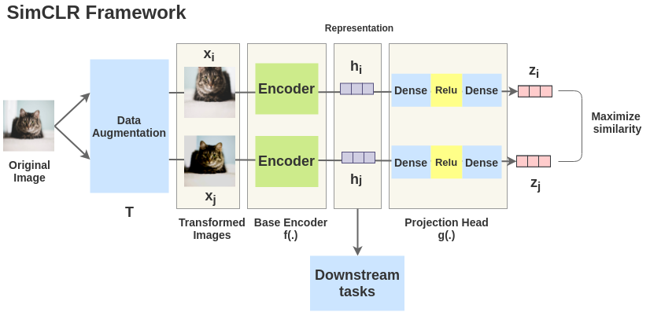
SimCLR: Learning visual representations
SimCLR is a simple framework for contrastive learning of visual representations which not only outperforms previous work on the subject, but is also much simpler and requires no specialized architectures nor a memory bank. SimCLR learns representations by maximizing agreement between differently augmented views of the same image via a contrastive loss in the latent space.
Go to the Appendix A for more info

Slide 7
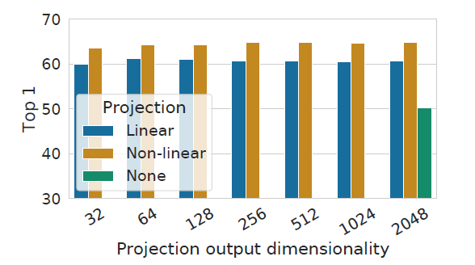
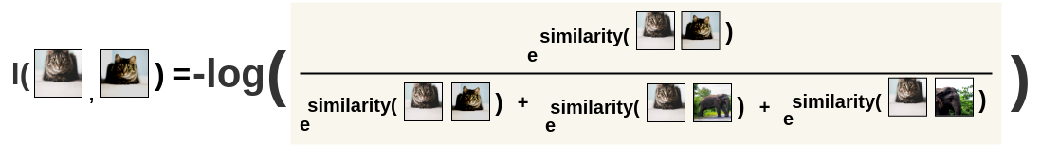
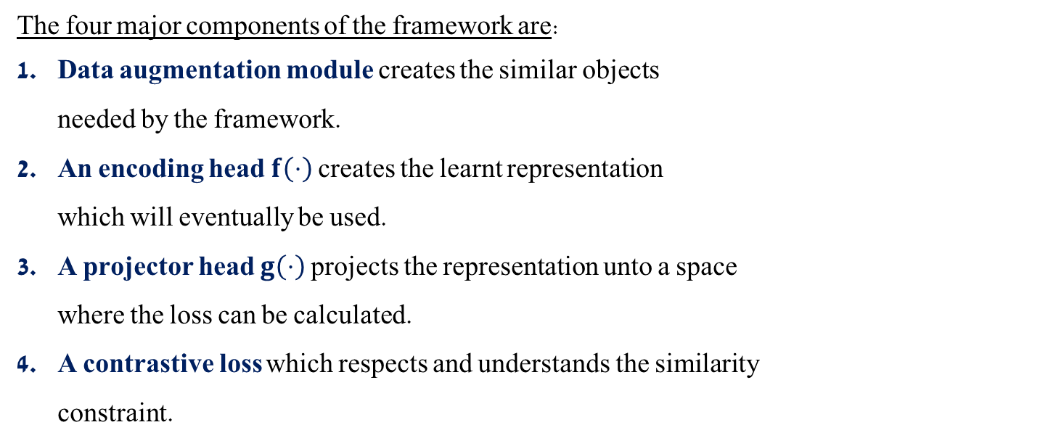
SimCLR: Components
The four major components of the framework are:
Data augmentation module creates the similar objects needed by the framework.
An encoding head $f\left(⋅\right)$ creates the learnt representation which will eventually be used.
A projector head $g\left(⋅\right)$ projects the representation unto a space where the loss can be calculated.
A contrastive loss which respects and understands the similarity constraint.
Go to the Appendix B for more info
Notes:
The four major components of the framework are:
Data augmentation module- A stochastic data augmentation module that transforms any given data example randomly resulting in two correlated views of the same example, which we consider as a positive pair. To understand the effects of individual data augmentations and the importance of augmentation composition, the writers investigate the performance of this framework when applying augmentations individually or in pairs. They observe that no single transformation suffices to learn good representations, even though the model can almost perfectly identify the positive pairs in the contrastive task. One composition of augmentations stands out: random cropping and random color distortion. They create color histograms of pixel intensities over all channels for different crops of two different images and observe that it suffice to distinguish images. Neural nets may exploit this shortcut to solve the predictive task. Therefore, it is critical to compose cropping with color distortion in order to learn generalization features. When training supervised models with the same set of augmentations, we observe that stronger color augmentation doesn’t improve or even hurts their performance. Thus, the experiments, which have conducted in this research, show that unsupervised contrastive learning benefits from stronger(color) data augmentation than supervised learning.
An encoding head $f\left(⋅\right)$- A neural base encoder $f\left(⋅\right)$ that extracts representation vectors from augmented data examples. In this framework, they use ResNet-50 as a base encoder network.
A projection head $g\left(⋅\right)$- A small neural network projection head $g\left(⋅\right)$ that maps representations to the space where contrastive loss is applied. In this framework, they use a 2-layer MLP projection head to project the representation to a 128-dimensional latent space. In order to study the importance of including a projection head they compare linear evaluation of representations with different heads $g\left(⋅\right)$: linear projection, nonlinear projection and none projection at all and various dimensions. They observe that a nonlinear projection is better than linear projection and much better than no projection. When a projection head is used, similar results are observed regardless of output dimension. Furthermore, even when nonlinear projection is used, the layer before the projection head is still much better than the layer, which shows that the hidden layer before the projection head is better representation than the layer after. The researchers conjecture that the importance of using the representation before the nonlinear projection is due to loss of information induced by the contrastive loss. Thus, $g\left(⋅\right)$ can remove information that may be useful for the downstream task, such as the color or orientation of objects.
A contrastive loss- A contrastive loss function defined for a contrastive prediction task. More info about it in the next slide.

Slide 8
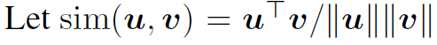

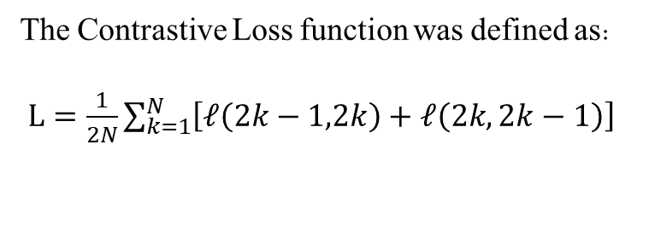
NT-Xent: Normalized Temperature-Scaled Cross Entropy
$$ℓ\left(z_{i},z_{j}\right)=−log\frac{\exp\left(\frac{sim\left(z_{i},z_{j}\right)}{τ}\right)}{\sum_{k=1}^{2N}{I\left(k≠i\right)⋅\exp\left(\frac{sim\left(z_{i},z_{k}\right)}{τ}\right)}}$$
$$⇒$$
The Contrastive Loss function was defined as:
$L=\frac{1}{2N}\sum_{k=1}^{N}{\left[ℓ\left(2k−1,2k\right)+ℓ\left(2k,2k−1\right)\right]}$
Notes:
As you can see in this slide, contrastive loss is a function of the cosine similarity* function.
The writers of the article compare the NT-Xent* loss against other commonly used contrastive loss functions, such as logistic loss and margin loss. To make the comparisons fair, they use the same l2 normalization for all loss functions, and they tune the hyper parameters and report their best results for models trained. The best result was still their default NT-Xent loss.
In addition, they choose our instantaneous loss function to be the NT-Xent loss, because of its easy interpretability where minimizing the loss is essentially maximizing the similarity between ${x=z}_{i},x^{+}=z_{j}$ and minimizing the similarity between $x=z_{i},x^{−}={\left\{z_{k}\right\}}_{k≠i,j}$.
$$ℓ\left(z_{i},z_{j}\right)=−log\frac{\exp\left(\frac{sim\left(z_{i},z_{j}\right)}{τ}\right)}{\sum_{k=1}^{2N}{I\left(k≠i\right)⋅\exp\left(\frac{sim\left(z_{i},z_{k}\right)}{τ}\right)}}$$
$$⇒$$
$$↓ℓ\left(z_{i},z_{j}\right)=\log\left[1+ \frac{\sum_{k=1}^{2N}{I\left(k≠i,j\right)⋅\exp\left(\frac{↓sim\left(z_{i},z_{k}\right)}{τ}\right)}}{\exp\left(\frac{↑sim\left(z_{i},z_{j}\right)}{τ}\right)}\right]$$
The final loss is computed across all positive pairs, both (i,j) and (j,i), in a mini batch. This loss used in previous work of Sohn, 2016; Wu et al., 2018; Oord et al., 2018). The Contrastive Loss function was defined as:
$$L=\frac{1}{2N}\sum_{k=1}^{N}{\left[ℓ\left(2k−1,2k\right)+ℓ\left(2k,2k−1\right)\right]}$$
*NT-Xent is an abbreviation for “Normalized Temperature* scaled Cross Entropy”.
*Temperature is a hyper-parameter of LSTMs(and neural networks generally) used to control the randomness of predictions by scaling the logits before applying softmax.
*Cosine similarity is a measure of similarity between two non-zero vectors of an inner product space.

Slide 9
Simulation
Notes:
Step by step of the model
We have a large data set of unlabeled images and would like to learn a contrastive representation.
We generate a batch of N images and apply our transformations on each image to receive 2N augmented images.
We pass the augmented images through the encoder $f(⋅)$ and the projection head $g(f\left(⋅\right))$.
Referring to our structured framework we now have the following data structure $Z=(z,z^{+},{\left\{z_{i}^{−}\right\}}_{i=1}^{k}$).
We define our similarity as the Cosine Similarity which has mentioned in the previous slide:
$$sim\left(z_{i},z_{j}\right)=\frac{⟨z_{i},z_{j}⟩}{\left\|z_{i}\right\|⋅\left\|z_{j}\right\|}$$
And we hope that in the ideal case the similarities will follow our logic.
Training the model
In the mentioned framework, the training batch size N moved from 256 to 8192. A batch size 8192 gives us 16,382 negative examples per positive pair from both augmentation views. Training with large batch size may be unstable when using standard SGD/Momentum with linear learning rate scaling. To stabilize the training, they use the LARS optimizer for all batch sizes. Moreover, they train the model with Cloud TPUs*, using 32 to 128 cores depending on the batch size.
This research shown when the number of training epochs is small(e.g. 100 epochs), larger batch sizes have a significant advantage over the smaller ones. With more training steps, the gaps between different batch sizes decrease or disappear.
They observe that contrastive learning benefits from larger batch sizes and longer training compared to its supervised counterpart.
Default setting
As I mentioned before, they use ResNet 50 as the base encoder network, and a 2-layer MLP projection head to project the representation to a 128-dimensional latent space. Standard ResNet use batch normalization(BN). In distributed training with aggregated locally per device. In our contrastive learning, as positive pair are computed in the same device, the model can exploit the local information leakage to improve prediction accuracy without improving representations. They address this issue by aggregating BN mean and variance over all devices during the training.
The researchers use NT-Xent loss function, optimized using LARS* with learning rate of 4.8(=0.3 * batch size/256) and weight decay of 10^(-6). Moreover, they train at batch size 4096 for 100 epochs.
*Cloud TPU is the custom-designed machine learning ASIC that powers Google products.
*Layer-wise Adaptive Rate Scaling, or LARS, is a large batch optimization technique. There are two notable differences between LARS and other adaptive algorithms such as Adam or RMSProp: first, LARS uses a separate learning rate for each layer and not for each weight. And second, the magnitude of the update is controlled with respect to the weight norm for better control of training speed.

Slide 10
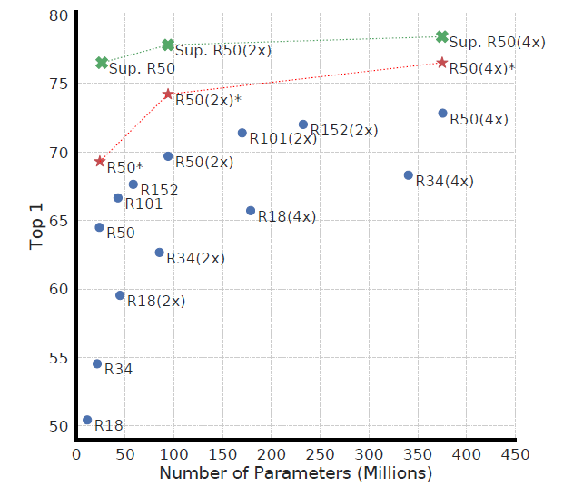
Results of the Article
Figure 7. Linear evaluation of models with varied depth and width. Models in blue dots are ours trained for 100 epochs, models in red stars are our trained for 1000 epochs, and models in green crosses are supervised ResNets trained for 90 epochs (He el at., 2016)
Notes:
This figure shows linear evaluation of models with varied depth and width. Models in blue dots are ours trained for 100 epochs, models in red stars are our trained for 1000 epochs, and models in green crosses are supervised ResNets trained for 90 epochs. It shows, perhaps unsurprisingly, that increasing depth and width both improve performance. While similar findings hold for supervised learning, the researchers find the gap between supervised models and linear classifiers trained on unsupervised models shrinks as the model size increases, suggesting that unsupervised learning benefits more from bigger models than supervised counterpart.

Slide 11
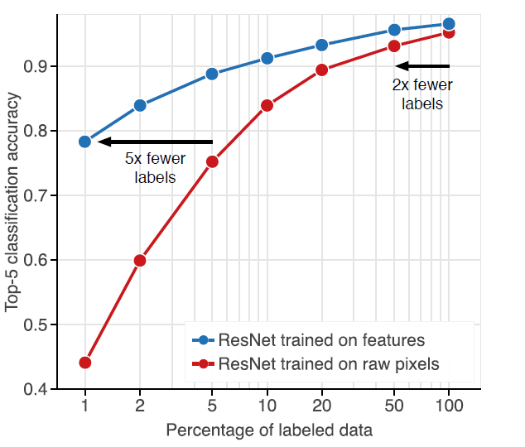
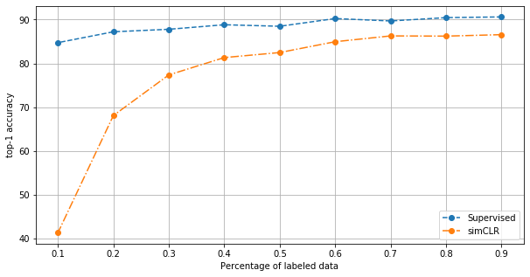
Real Results
Figure 7. Depicting the change in accuracy in linear classifiers
Finetuned on decreasing amounts of representations produced by simCLR
and by a supervised ResNet pre-trained on ImageNet. simCLR provides
Competitive results but suffers more than its supervised counterpart.
Figure 1. Depicting the change in accuracy of supervised and unsupervised
Classifiers when trained on decreasing amounts of labeled data. Unsupervised
Classifiers retain high accuracy even when trained on small datasets and can
Achieve competitive accuracy with significantly fewer labels (horizontal arrows).
Notes:
The first figure describes the change in accuracy of supervised and unsupervised classifiers when trained on decreasing amounts of labeled data. Unsupervised classifiers retain high accuracy even when trained on small datasets and can
achieve competitive accuracy with significantly fewer labels(horizontal arrows).
The latter figure depicts the change in accuracy in linear classifiers fine-tuned on decreasing amounts of representations produced by simCLR, and by a supervised ResNet pre-trained on ImageNet. simCLR provides competitive results, but suffers more than its supervised counterpart.

Slide 12
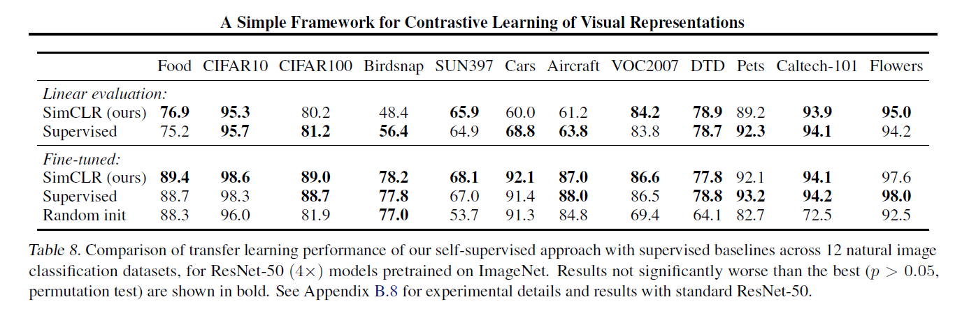
Results of the Article
Notes:
The researchers evaluated the performance of simCLR for transfer learning in two settings: linear evaluation, where a logistic regression classifier is trained to classify a new dataset based on the self-supervised representation learned on ImageNet, and fine-tuned, where they allow all weights to vary during training. The comparison was conducted across 12 natural image classification datasets, for ResNet-50 (*4) models pretrained on ImageNet.
Under the linear evolution protocol, we can observe that our self-supervised model significantly outperforms the supervised baseline on 4 datasets(i.e. Food, SUN397, VOC2007 and Flowers datasets).
When fine-tuned on those natural image classification datasets, simCLR performs on par with or better than supervised baseline on 10 out of 12 datasets. As we can see on this table, the supervised baseline is superior on only 2(i.e. Pets and Flowers datasets).
When they check these comparisons on standard ResNet , the supervised ResNet-50 model outperforms the self-supervised model on all datasets with linear evaluation, and most(10 of 12) datasets with fine-tuned. The weaker performance on ResNet model compared to the ResNet (*4) model may relate to the accuracy gap between the supervised and self-supervised models on ImageNet.
These results shows no clear advantage to the supervised or self-supervised models.
More related info
For transfer learning via linear evaluation, the researchers trained an l2-regularized multinomial logistic regression classifier on features extracted from the frozen pretrained network. They used L-BFGS to optimize the softmax cross-entropy objective using bicubic resampling, after which they took a 224*224 center crop. As pre-processing, all images were resized to 224 pixels along the shorter side range of 45 logarithmically spaced values between 10^(-6) and 10^(-5).
For transfer learning via fine-tuning, the writers of the article fine-tuned the entire network using the weights of the pretrained network as initialization. They trained for 20,000 steps at a batch size of 256 using SGD with Nesterov momentum with a momentum parameter of 0.9. As data augmentation during fine-tuning, they performed only random crops and resize and flips. At test time, they resized images to 256 pixels along the shorter side and took a 224*224 center crop. Moreover, they selected the learning rate and weight decay, with a grid of 7 logarithmically spaced learning rates between 0.0001 and 0.1 and 7 logarithmically spaced values of weight decay between 10^(-6) and 10^(-3), as well as no weight decay.
For supervised baselines, the researchers compare against architecturally identical ResNet models trained on ImageNet with standard cross-entropy loss. These models are trained with the same data augmentation as our self-supervised models(crops, strong color augmentation and blur) and are also trained for 1000 epochs. They found that, these models performed significantly better than a supervised baseline trained for 90 epochs and ordinary data augmentation for linear evaluation on a subset of transfer datasets.

Slide 13
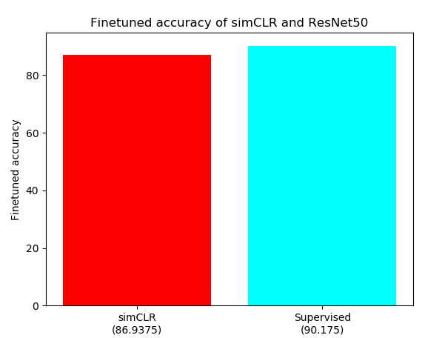
Real Results
A simplified implementation that uses googles pre-trained weights and a fine-tuned multiclass logistic classifier
on the STL-10 dataset shows that simCLR provides competitive results with the supervised counterpart using
the ResNet-50 (1x) encoding head.
Figure 6. Top-1 accuracy of linear classifiers fine-tuned on top of representations
learnt by simCLR and by a supervised method. Code for result recreation can be
found at : https://github.com/TomerHimi/Machine_Learning_Seminar
Notes:
STL-10 Image Recognition dataset
The STL-10 dataset is an image recognition dataset for developing unsupervised feature learning, deep learning, self-taught learning algorithms. It is inspired by the CIFAR-10 dataset, but with some modifications. In particular, each class has fewer labeled training examples than in CIFAR-10, but a very large set of unlabeled examples is provided to learn image models prior to supervised training. The primary challenge is to make use of the unlabeled data(which comes from a similar but different distribution from the labeled data) to build a useful prior. We also expect that the higher resolution of this dataset (96x96) will make it a challenging benchmark for developing more scalable unsupervised learning methods.
Data Overview:
10 classes: airplane, bird, car, cat, deer, dog, horse, monkey, ship, truck.
Images are 96x96 pixels, color.
500 training images(10 pre-defined folds), 800 test images per class.
100,000 unlabeled images for unsupervised learning. These examples are extracted from a similar but broader distribution of images. For instance, it contains other types of animals (bears, rabbits, etc.) and vehicles (trains, buses, etc.) in addition to the ones in the labeled set.
Images were acquired from labeled examples on ImageNet.
In this graph, we can observe top-1 accuracy of linear classifiers fine-tuned on top of representations learnt by simCLR and by supervised method. According to these findings, simCLR provides competitive results with the supervised counterpart using
the ResNet-50 (*1) encoding head.

Slide 14
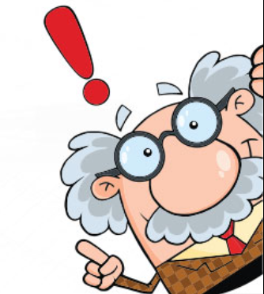
Conclusions
Supervised methods are still much better at creating meaningful representations.
The success of this framework rekindles interest in self-supervised and unsupervised pre-training methods.
SimCLR’s results show that the complexity of previous methods for self-supervised learning is not necessary.
Even though its simple to implement, the framework requires extensive computing power.
It opens room for thought about more methods which mimic the human brain.
Notes:
Conclusions
Supervised methods are still much better at creating meaningful representations and I disagree with many papers that try to compete with supervised methods. The main issue is the lack of labeled data.
The success of this framework rekindles interest in self-supervised and unsupervised pre-training methods as seen by the many new articles released on this subject recently.
SimCLR’s results show that the complexity of previous methods for self-supervised learning is not necessary and generally opens room for thought about how complex a model should be.
Theoretical understanding of contrastive learning is lacking, results are treated to an obvious consequence. New theoretical analysis based on PAC-Bayes has emerged recently and has already allowed the creation of new contrastive algorithms based on its bounds.
Even though its simple to implement, the framework requires extensive computing power. It benefits from larger batch sizes and longer training.
It opens room for thought about more methods which mimic the human brain.

Slide 15
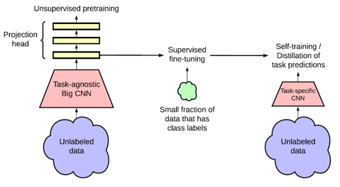
What’s next ?
SimCLR V2 is an improvement on SimCLR which explores different encoding heads, projection heads and different training techniques. A major change is the way unlabeled data is used twice. Once to generate task-agnostic representations and once again to distill the representations towards a specific task.
Figure 7. Depicts the process of creating preliminary task-agnostic
Representations and then finetuning them towards task-specific
Representations with the SimCLRv2 method.
Notes:
You can read more relevant information about SimCLR V2 in the second file in the references which refers to this slide.

Slide 16
References
A Simple Framework for Contrastive Learning of Visual Representations (Original paper) https://arxiv.org/pdf/2002.05709.pdf
Big Self-Supervised Models are Strong Semi-Supervised Learners (simCLR Version 2) https://arxiv.org/pdf/2006.10029.pdf
Representation Learning: A Review and New Perspectives https://arxiv.org/pdf/1206.5538.pdf
Google’s GitHub for both versions of the framework (TensorFlow) https://github.com/google-research/simclr
A PyTorch implementation by sthalles https://github.com/sthalles/SimCLR

Slide 17
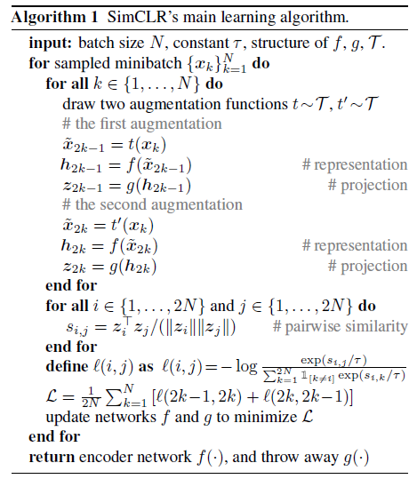
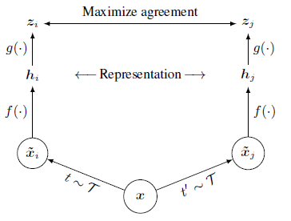
Appendix A- Framework of the Method
Go back
Notes:
A simple framework for contrastive learning of visual representations. Two separate data augmentation operators are sampled from the same family of augmentations (t~T and t’~T) and applied to each data example to obtain two correlated views. A base encoder $f\left(⋅\right)$ and a projection head $g\left(⋅\right)$ are trained to maximize agreement using a contrastive loss. After training is completed, we throw away the projection head $g\left(⋅\right)$ and use encoder $f\left(⋅\right)$ and representation h for downstream tasks.
The algorithm shown from the left in this slide summarizes this proposed method.

Slide 18
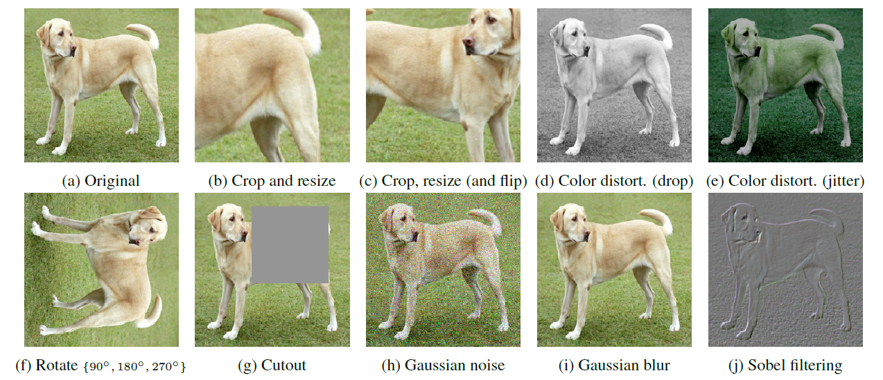
Appendix B- Augmentations
Go back
Notes:
Illustrations of the studied augmentation operators. Note that the writers only test these operators in ablation, the augmentation policy used to train our models only includes random crop(with flip and resize), color distortion and Gaussian blur.
*Data augmentation in data analysis are techniques used to increase the amount of data by adding slightly modified copies of already existing data or newly created synthetic data from existing data. It acts as a regularizer and helps reduce overfitting when training a machine learning model

